Slide 1
A DataVerse Beyond The Internet
Jorrit Poelen https://jhpoelen.nl

Slide 2
Guiding Questions
How do you cite data?
How do you look up cited data now?
How do you look up cited data 40 years from now?

Slide 3

There’s A Kitty In The DataVerse…
Harvard Kitty

Slide 4
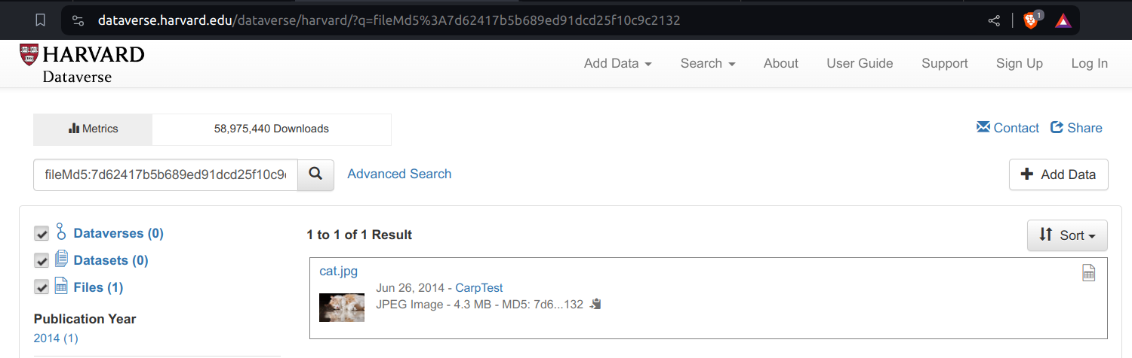
There’s A Kitty In The DataVerse…
Harvard Kitty Internet Page

Slide 5
So How’d You Cite This Kitty Picture?
Joshua Carp, 2014, “cat.jpg”, CarpTest, https://doi.org/10.7910/DVN/24358/N4FCVS, Harvard Dataverse, V1 ¹

Slide 6
How To Retrieve This Kitty Picture Now?
Like this?
curl -L "https://doi.org/10.7910/DVN/24358/N4FCVS"\ > cat.jpg

Slide 7
How To Retrieve This Kitty Picture Now?
Wait a minute …
cat cat.jpg | head -n2
<?xml version='1.0' encoding='UTF-8' ?> <!DOCTYPE html>
That ain’t no cat, it is an HTML page.

Slide 8
How To Retrieve This Cat Picture Now?
Take 2.
turn on the internet (still there?)
open a web browser
load https://doi.org/10.7910/DVN/24358/N4FCVS
and rely on a delicate and complex socio-technical network
inspect page
use mouse to click on a link that looks like cat.jpg
download image and trust its authenticity

Slide 9
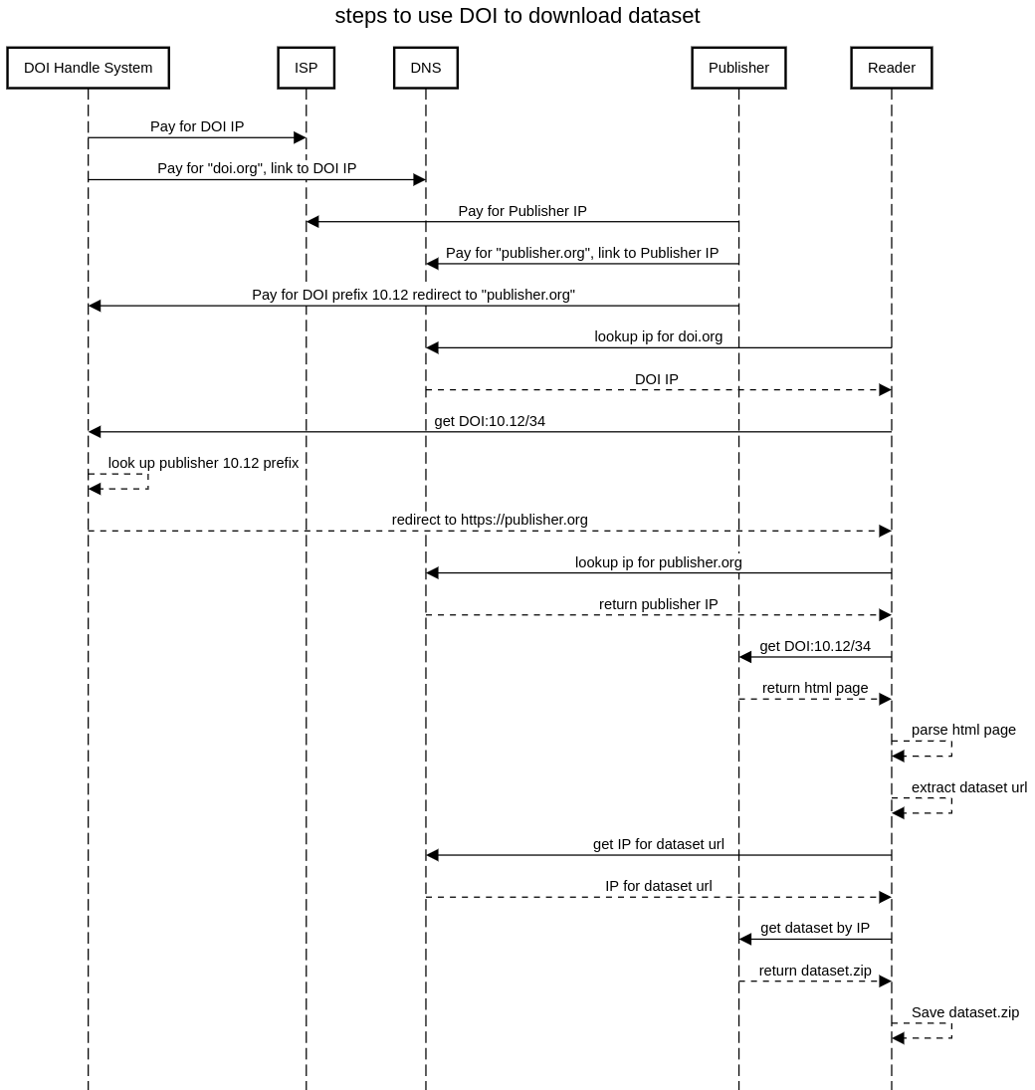
DOI Economics and Redirection
DOI Redirection Sequence Diagram

Slide 10
How To Retrieve This Cat Picture 50 Years From Now?
Joshua Carp, 2014, “cat.jpg”, CarpTest, https://doi.org/10.7910/DVN/24358/N4FCVS, Harvard Dataverse, V1
Likely will not work due to intricate network of dependencies.

Slide 11
How To Retrieve This Cat Picture 50 Years From Now?
Proposal: Sign the citation ²
… by adding the digital fingerprint of the image.
Joshua Carp, 2014, “cat.jpg”, CarpTest, https://doi.org/10.7910/DVN/24358/N4FCVS, Harvard Dataverse, V1 hash://md5/7d62417b5b689ed91dcd25f10c9c2132

Slide 12
How To Retrieve This Cat Picture 50 Years From Now?
… by searching the world (in, and beyond, the internet) for the content with the unique fingerprint hash://md5/7d62417b5b689ed91dcd25f10c9c2132 .
https://linker.bio/hash://md5/7d62417b5b689ed91dcd25f10c9c2132
https://dataverse.harvard.edu/dataverse/harvard/?q=fileMd5%3A7d62417b5b689ed91dcd25f10c9c2132
preston cat --remote https://dataverse.harvard.edu hash://md5/7d62417b5b689ed91dcd25f10c9c2132
preston cat --remote https://dataverse.org hash://md5/7d62417b5b689ed91dcd25f10c9c2132
preston cat --remote https://linker.bio,https://dataverse.org hash://md5/7d62417b5b689ed91dcd25f10c9c2132

Slide 13
Let Us Carry Our Cat Pictures Into The Future…
preston cat\ --remote "https://dataverse.org"\ hash://md5/7d62417b5b689ed91dcd25f10c9c2132\ > cat.jpg
Harvard Kitty

Slide 14
Guiding Questions
How do you cite data?
How do you look up cited data now?
How do you look up cited data 40 years from now?

Slide 15
#Extra

Slide 16
Internet Is Designed For Exchanging Information
The internet is a powerful tool for exchanging digital information. But the Internet’s contents changes constantly: websites are launched and taken down, webpages change, and content gets archived or lost.³

Slide 17
Internet Is Location-based
By design, a web address, or Uniform Resource Locator (URL), points to a specific internet location from which a resource, like a webpage, can be retrieved. However, a URL does not provide a way to verify that a retrieved webpage was the one we asked for. ⁴

Slide 18
Finding Content By Their Location Is … Tricky
Imagine using a URL-like reference to find a book at a library: instead of locating a book by what it is (e.g., title, author), you refer to a book by its location (e.g., third shelf on the second row next to the window). With this, a book becomes unfindable if moved to another shelf. And, if you do manage to find a book at the referenced location, how would you know you’ve found the book you are looking for? ⁵

Slide 19
Finding Content By Their (Summarized) Content Is … What Librarians Do
Instead of pointing to where books are located, librarians point to them using a bibliographic reference. For practical reasons, only a few identifying clues are included in such a reference (e.g., author, year of publication, title, and publisher). So, librarians refer to content by what it is, and knowing where it may be located is secondary. ⁶
A bibliographic citation:
Darwin, C. 1859. On the Origin of Species. John Murray.

Slide 20
Notes
1. As suggested in https://dataverse.harvard.edu/file.xhtml?persistentId=doi:10.7910/DVN/24358/N4FCVS accessed on 2024-02-06 https://dataverse.org/best-practices/data-citation
2. Elliott M.J., Poelen, J.H. & Fortes, J.A.B. (2023) Signing data citations enables data verification and citation persistence. Sci Data. https://doi.org/10.1038/s41597-023-02230-y hash://sha256/f849c870565f608899f183ca261365dce9c9f1c5441b1c779e0db49df9c2a19d
3. Jorrit Poelen. 2024. Unleashing Digital Knowledge Into The Future. Accessed on 2024-02-06 at https://linker.bio line:hash://sha256/8ac18eb75ff20d40d1d60bb6ad5a745eb528093d1ffbe373e3847c13146091eb!/L12
4. Jorrit Poelen. 2024. Unleashing Digital Knowledge Into The Future. Accessed on 2024-02-06 at https://linker.bio line:hash://sha256/8ac18eb75ff20d40d1d60bb6ad5a745eb528093d1ffbe373e3847c13146091eb!/L14
5. Jorrit Poelen. 2024. Unleashing Digital Knowledge Into The Future. Accessed on 2024-02-06 at https://linker.bio line:hash://sha256/8ac18eb75ff20d40d1d60bb6ad5a745eb528093d1ffbe373e3847c13146091eb!/L16
6. Jorrit Poelen. 2024. Unleashing Digital Knowledge Into The Future. Accessed on 2024-02-06 at https://linker.bio line:hash://sha256/8ac18eb75ff20d40d1d60bb6ad5a745eb528093d1ffbe373e3847c13146091eb!/L18

